Slide 1



Measuring the Atmosphere of the Hot Jupiter WASP-43b with Gemini-S/IGRINS
Dare Bartelt¹ Megan Weiner Mansfield¹, Dániel Apai¹
¹University of Arizona

Slide 2
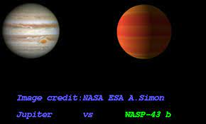
Exoplanets and Why We’re Interested
Exoplanets = planets outside the Solar System
WASP-43b is a Hot Jupiter; it is a gaseous planet that orbits close to its host star
Understanding the composition of exoplanet atmospheres leads to an understanding of planet formation
Existing models cannot fully explain planetary formation
Image Credit: Extrasolar Planet’s Catalogue, Kyoto University

Slide 3
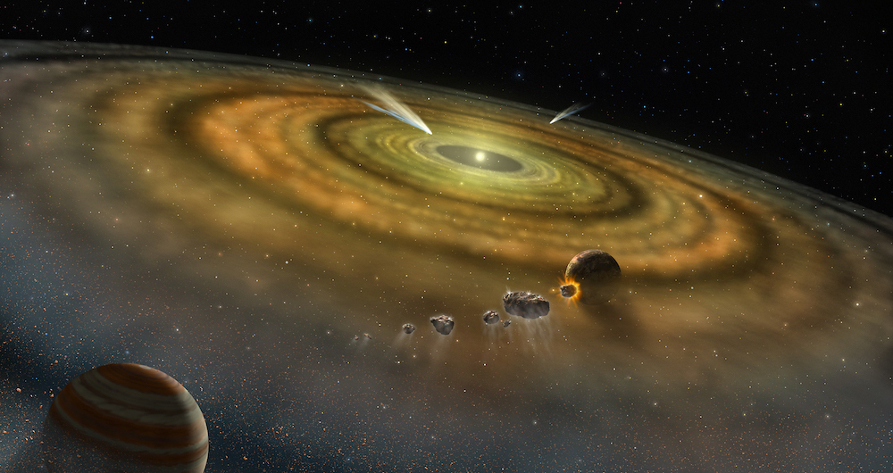
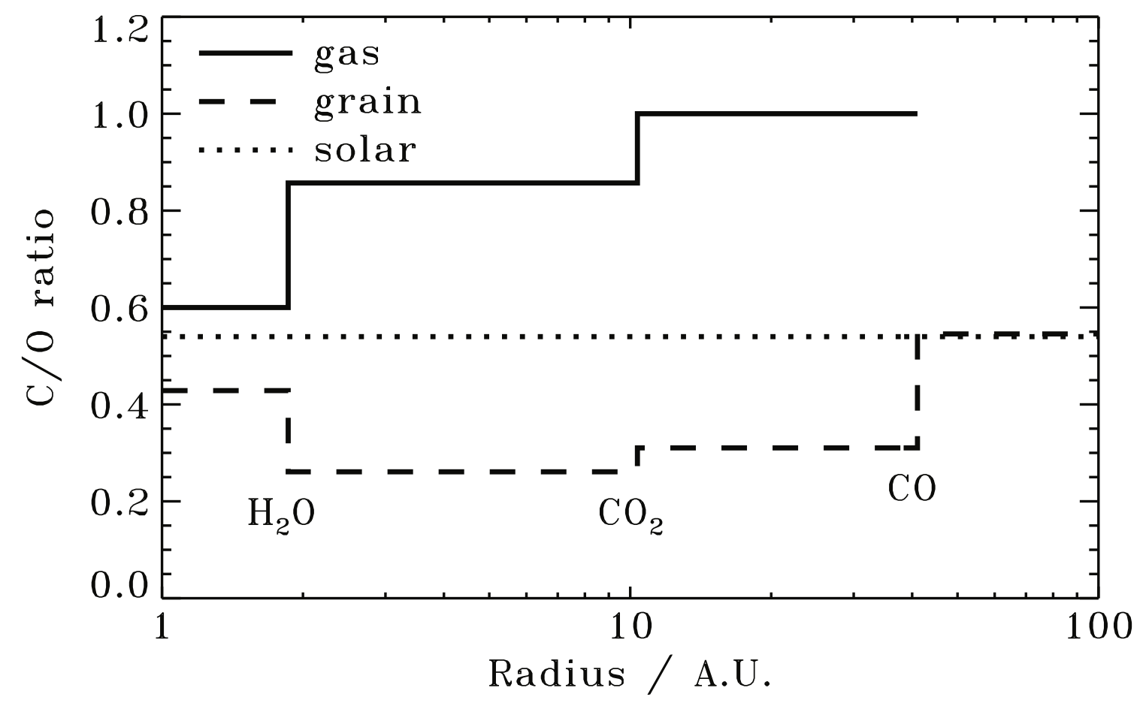
Motivations
There are no prior high-resolution studies on WASP-43b
Constrain the carbon-to-oxygen (C/O) ratio
The C/O ratio can connect the atmosphere to the formation and evolution of an exoplanet.
Image Credit: NASA
Figure from Oberg et al. (2011)
Notes:
Hubble data is only sensitive to water, can’t constrain C/O ratio

Slide 4
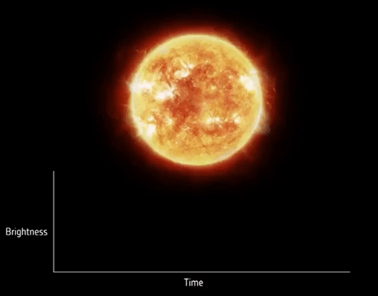
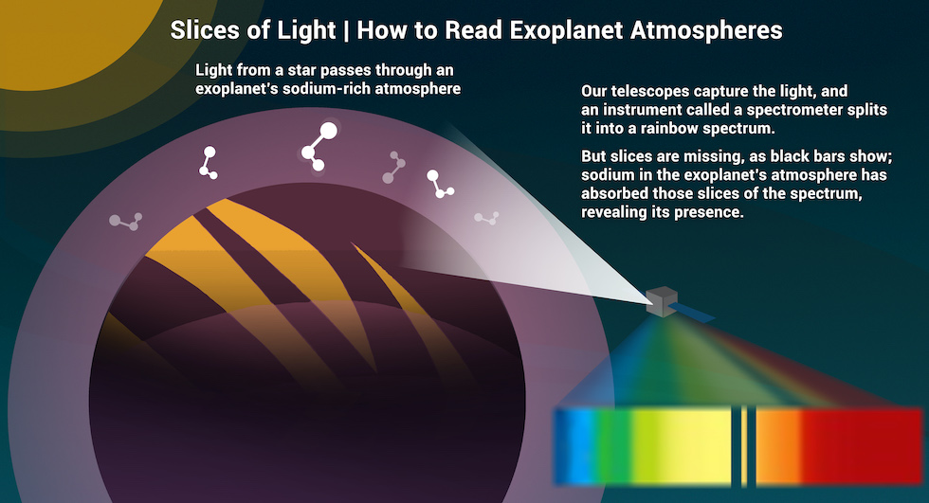

Observations
Performed by IGRINS, the spectrograph on the 8-meter Gemini-South telescope
Observes in near-infrared; detects features from $H_{2}O$, $CO$, ${CO}_{2}$, and ${CH}_{4}$
Four transits were observed
Video Credit: European Space Agency
Image Credit: NASA/JPL-Caltech/Lizbeth B. De La Torre

Slide 5
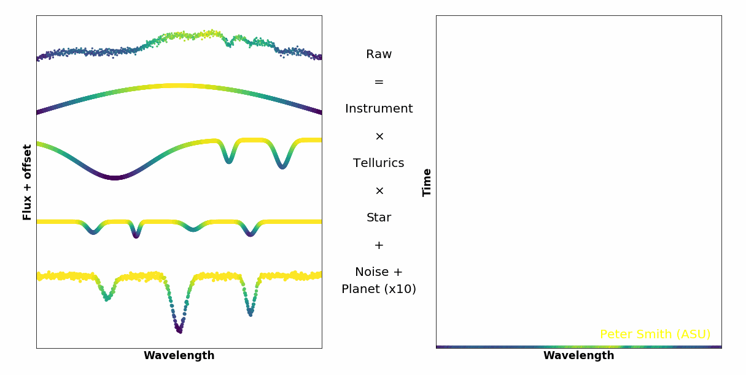
Data Reduction with Principal Component Analysis
Goal: Find the signal of the planet
Problem: The signal is blocked by tellurics, stellar signals, and instrument throughput
Solution: Use PCA to remove these stationary signals
Video Credit: Peter Smith, Arizona State University
Notes:
We can separate the planet out because it is Doppler shifting, so we can see its motion.

Slide 6
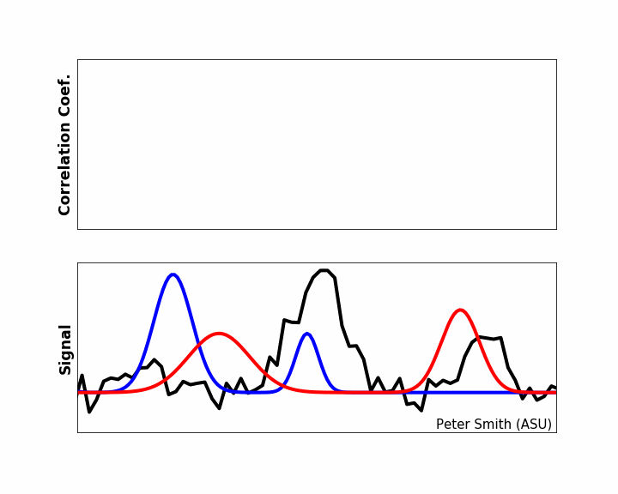
Detections using Cross-Correlation
Cross-correlation looks for models with the same features as the data
Absorption features from molecules are too small to identify by eye
Video Credit: Peter Smith, Arizona State University

Slide 7
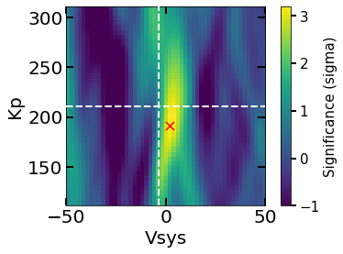
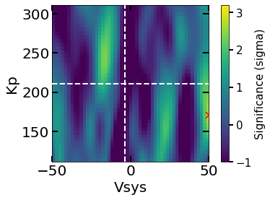
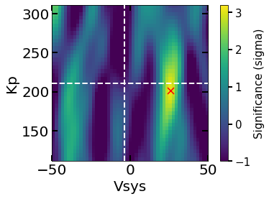
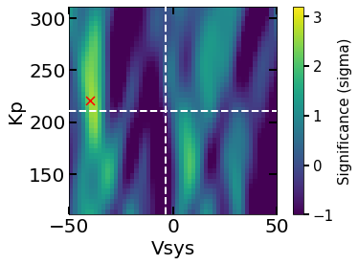





Findings and Results
Detection
No Detection
$$H_{2}O$$
$${CH}_{4}$$
Three transits were combined for the detections
Fourth transit not included due to inconsistencies caused by increased humidity
The detection of $H_{2}O$ is consistent with previous low-resolution observations
Detection?
No Detection
$${CO}_{2}$$
$$CO$$
Notes:
Explain the figures (Vsys is how fast the star-planet system is moving, Kp is the orbital velocity of WASP-43b, dashed lines are literature expectations)
If it’s only on one side, you wouldn’t see it moving at the velocity the planet is moving, you would see it with the planet’s velocity + an extra boost from the wind

Slide 8
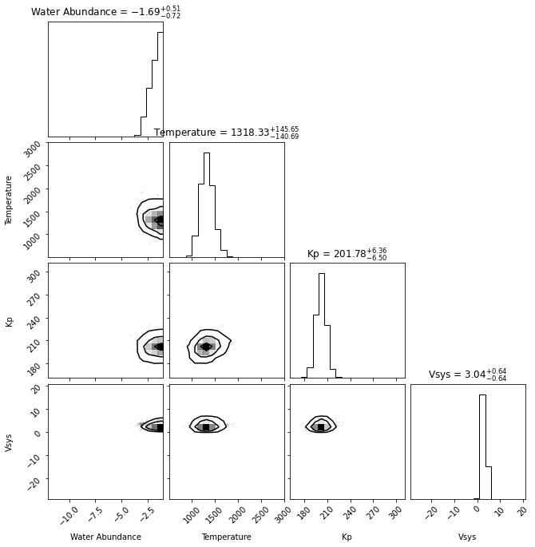


Retrieval of $H_{2}O$
We obtain a 2σ lower limit of 1.41$× {10}^{−4}$on the water volume mixing ratio
Consistent with previous Hubble data (2.4 × ${10}^{−4}$ – 2.1 × ${10}^{−3}$ , Kreidberg et al.)
Notes:
This is called a pairs plot
Temp. is isothermal, also assuming constant abundance

Slide 9
CO₂ “Detection”
The CO₂ “detection” has a detection significance of 3.09σ but comes with a significant velocity shift.
Split the CCF to examine both sides of the planet to see if CO₂ was present on one side only: Inconclusive.
Repeated observations might allow us to resolve the motion of the planet better, which would help us more confidently interpret this result.

Slide 10

Conclusion and Future Work
We obtain a 2σ lower limit of 1.41$× {10}^{−4}$on the water volume mixing ratio
Further observations could better resolve the CO₂ “detection”
I am currently writing a first-author paper on this research, set to be submitted to the Astrophysical Journal by May 2024!

Slide 11
Acknowledgements
Megan Weiner Mansfield, PhD, Steward Observatory
Daniel Apai, PhD, Steward Observatory
Michelle Coe, UArizona Space Grant & Statewide AZSGC Program Manager
Chandra Holifield Collins, PhD, Associate Director, UArizona Space Grant Program
Shirley Yancy, PhD, Assistant Director, UArizona Space Grant
Thank You!

Slide 12
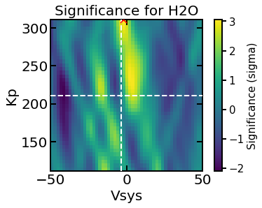
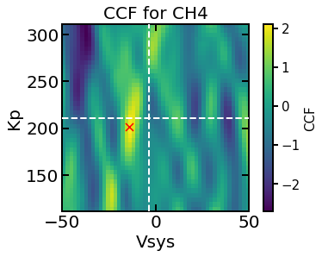
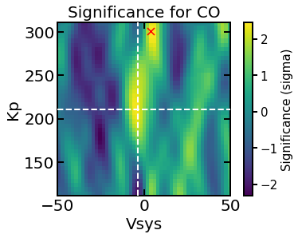
Night 4 Results - Humidity
Observation | Humidity
Night 1 | 32.8%
Night 2 | 21.2%
Night 3 | 25.7%
Night 4 | 43.4%
Night 4 has the highest humidity! This likely explains why there might be more water vapor contamination in the spectrum.

Slide 13
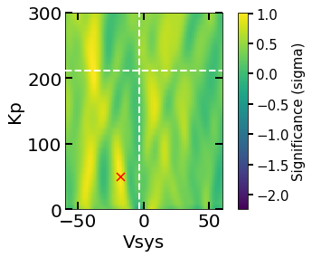
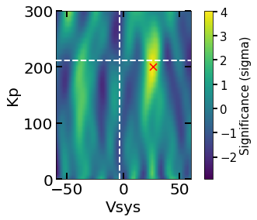




Why ${CO}_{2}$ and not $CO$?
$$CO$$
$${CO}_{2}$$
Re-performed cross-correlation on $CO$ and ${CO}_{2}$ using wider ranges for the velocities
Searching over a wider range of systemic and orbital velocities shows that the CO “detection” is on the scale of the random variations in the background noise

